Slide 1
Chapter 1: Introduction to Alice and Objects
Starting Out with Alice: A Visual Introduction to Programming
Second Edition
by Tony Gaddis

Slide 2
Chapter 1 Objectives
To understand:
the differences in dimensions between 2D and 3D objects.
what directions 2D and 3D objects move in a 3D world.
what the seven mouse mode buttons are (and which one does not appear in quad view).
how an object’s center point affects rotation.
what the three axes are that appear when an object is selected and what role they play in movement.
what the view of quad view are and how they work.
what the coordinates (0,0,0) mean in a 3D system.

Slide 3
Today’s Agenda
What is a Computer Program?
Algorithms and Programming Languages
Learning to Program with Alice
Objects
Classes and the Alice Galleries
3D Objects and the Camera

Slide 4
What is a Computer Program?
1.1
Computer is a device that follows instructions for manipulating and storing information.
How does the computer get those instructions?
A computer program is a set of instructions that the computer follows to perform a task.

Slide 5
What is a Computer Program?
1.1
Program
Set of instructions; carefully written so that they follow a logical sequence
When the computer performs those instructions, the computer is running or executing a program.
Steps are called
an ALGORITHM

Slide 6
Algorithms and Programming Languages
1.2
Algorithm
Set of well-defined logical steps
Must be performed in order to perform a task
Example…making a cup of instant coffee:
Remove lid from coffee jar
Put lid down on counter
Remove 1 tsp of coffee from jar
Place that coffee in a cup
Add 8 oz of boiling water to cup
Use teaspoon to stir water and coffee mixture
Stir 10 revolutions
Remove teaspoon from cup and place on counter
Is this adequate?
Is it detailed enough?
Is there anything ambiguous in what is written?

Slide 7
Algorithms and Programming Languages
1.2
Algorithms as written are understandable by humans (natural language)
Natural language is NOT understood by computers (machine language)
Blah
Blah
Blah
01100010011011000110000101101000001000000110001001101100011000010110100000100000
01100010011011000110000101101000

Slide 8
Algorithms and Programming Languages
1.2
Programming language converted to machine language by compiler or interpreter
Starting …010100110111010001100001011100100111010001101001011011100110011100100000
out …011011110111010101110100
With
…0111011101101001011101000110100000100000
Alice
…0100000101101100011010010110001101100101

Slide 9
Algorithms and Programming Languages
1.2
Operators
+ - * /
Perform arithmetic and other functions on data.
Syntax
Set of rules that must be followed.
Similar to the set of rules that are followed when people speak a natural language.
Writing the Program…writing the code
Program consists of keywords, operators, punctuation and more arranged in proper sequence
Save, compile, and voila! An executable program!

Slide 10
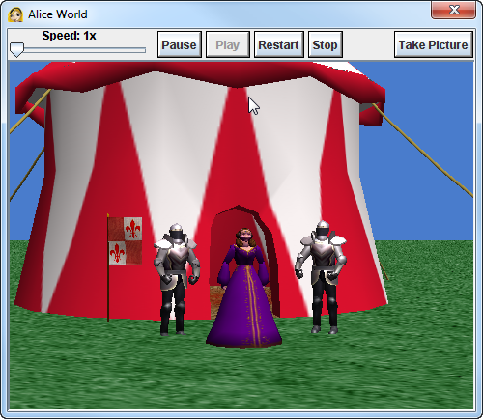
Learning to Program with Alice
1.3
Alice uses objects
Tent
Soldier
Princess
Objects perform actions
Turn
Move
Fly
Wave

Slide 11
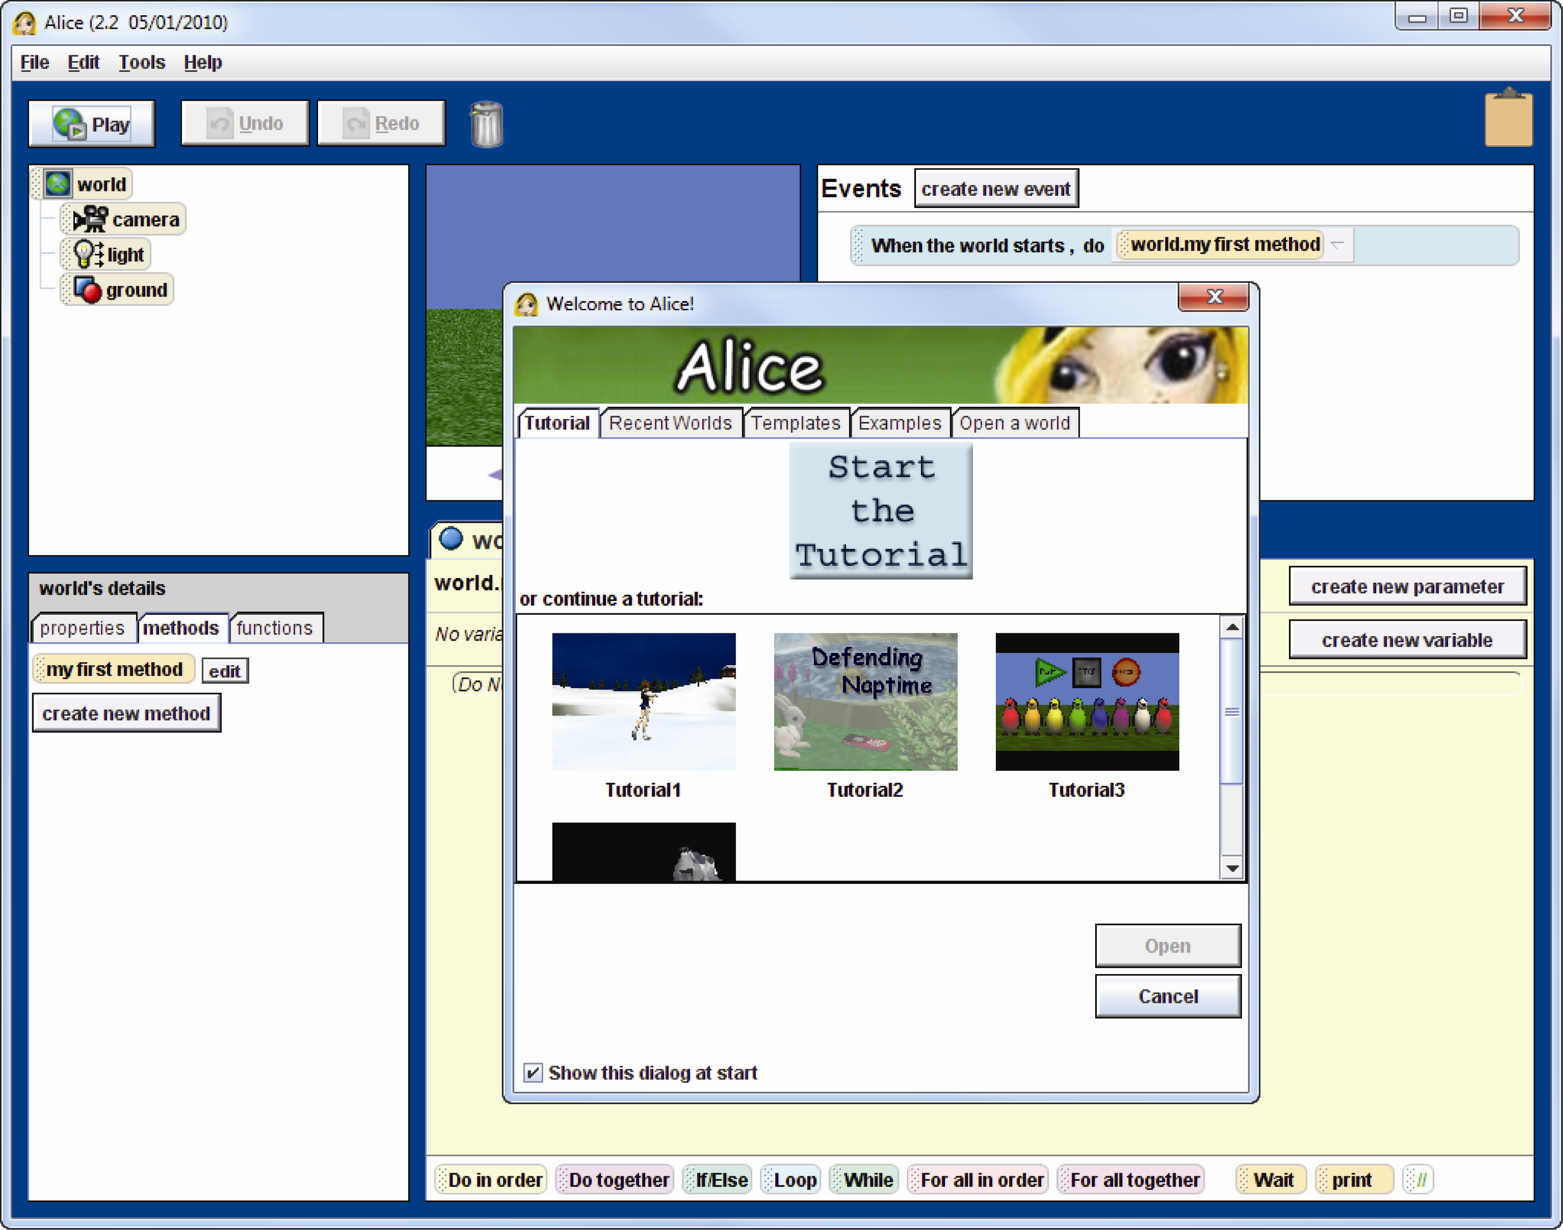
The Alice System
1.3

Slide 12
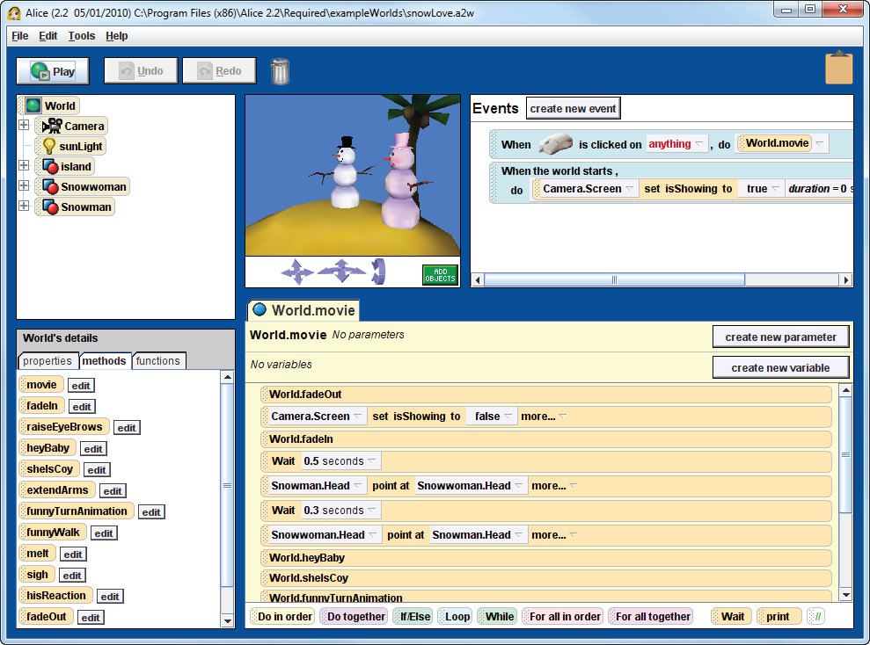
1.3
PLAY

Slide 13
The Alice Environment
1.3
World
View
Events
Editor
Toolbar
Object Tree
Details
Panel
Method Editor

Slide 14
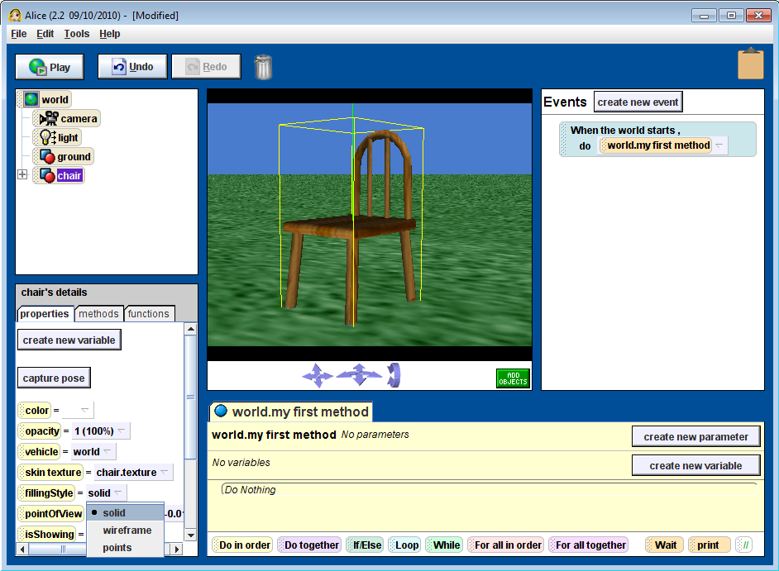
Object Properties
1.4
Object Selected
Change Properties

Slide 15
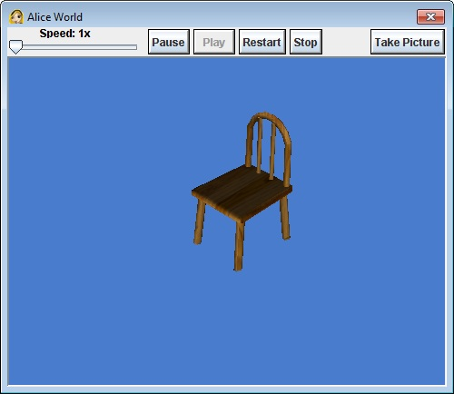
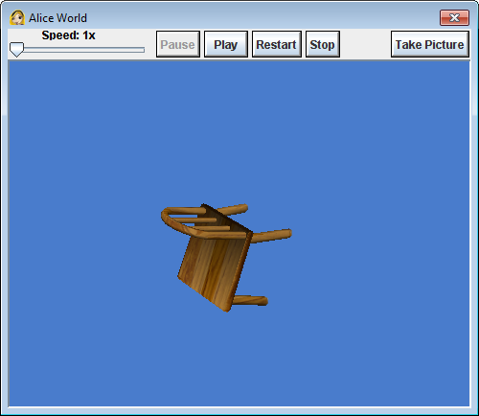
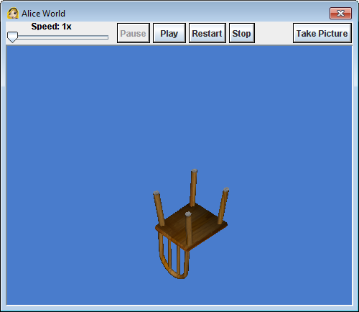
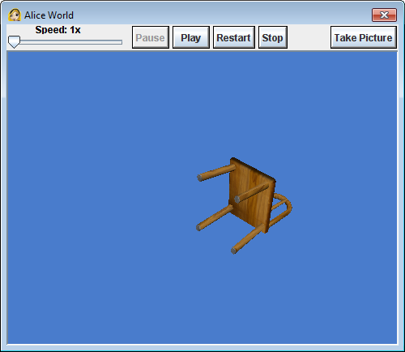
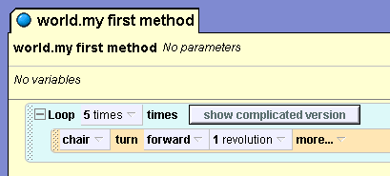
Methods
1.4
Set of programming statements executed by object.
Methods commonly result in object performing action.
My first method

Slide 16
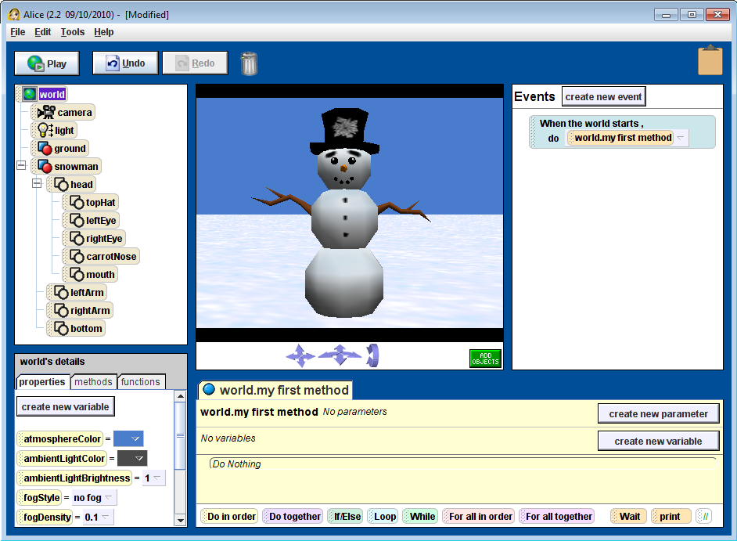
Methods
1.4
Objects made of other objects
Snowman made of:
head
topHat
leftEye
rightEye
carrotNose
mouth
leftArm
rightArm
bottom
NOTE: how objects are named!
This is called “camel case”

Slide 17
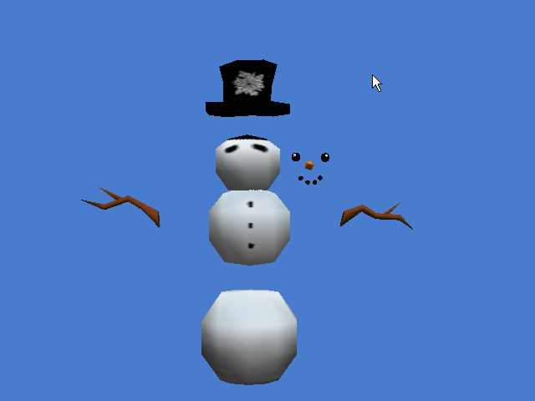
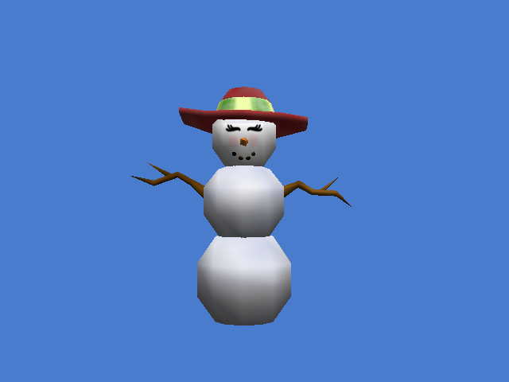
Methods
1.4
Each object can also be manipulated with methods.
Objects and “sub” objects can
Move
Turn
Roll
Say…

Slide 18
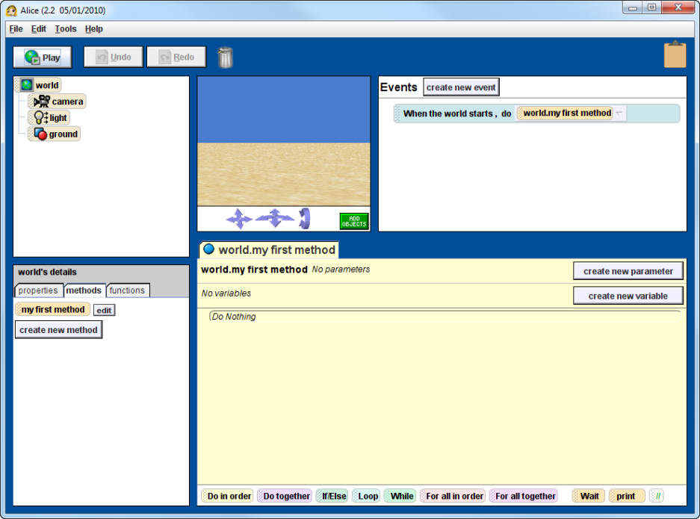
The World is My…object?
1.4
Contains all other objects
Also has its own properties
Atmosphere color
Lighting
Fog

Slide 19
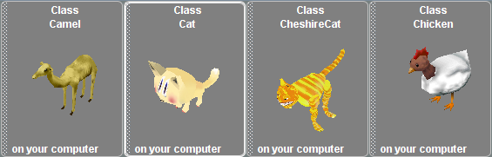
Alice has Class(es)!
1.5
Objects are created from classes.
Class set of specifications that describe a particular “type” of object.
Each item found in the Gallery is a class.
Each time the class is used, it is an instance of that class.
Gallery is a collection of different object types (animals, beach, people, etc.).
Two galleries are used:
Local gallery (stored on computer)
Web gallery (maintained by creators of Alice)

Slide 20
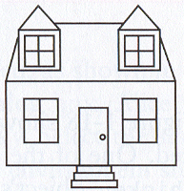
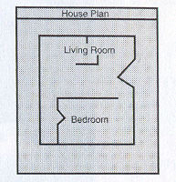
Blueprint that Describes a House
1.5
Three instances of the house created from the blueprint (class).

Slide 21
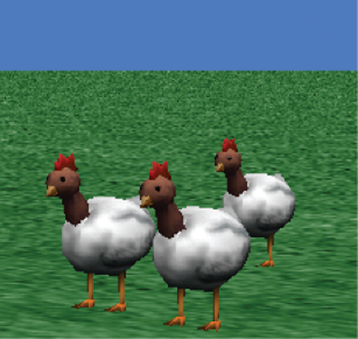
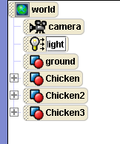
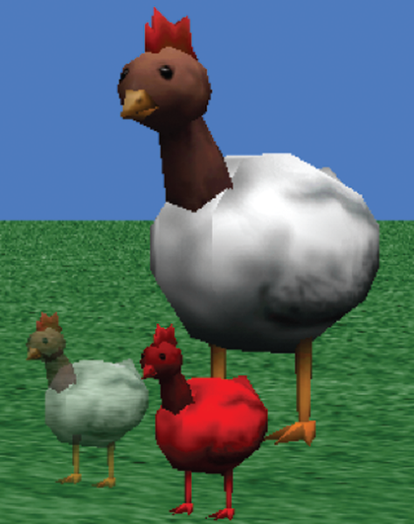
Class Instance in Alice
1.5
Class: Chicken
Instance:
Chicken1
Chicken2
Chicken2
Each instance has its own properties, methods, functions

Slide 22
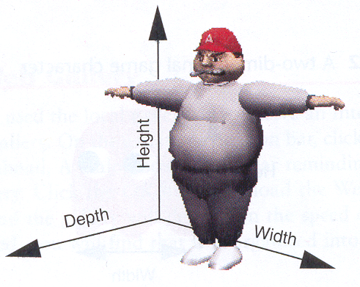
3D Objects and the Camera
1.6
Alice world and objects are three-dimensional
Height
Width
}
These dimensions are
part of 2D objects
Depth

Slide 23
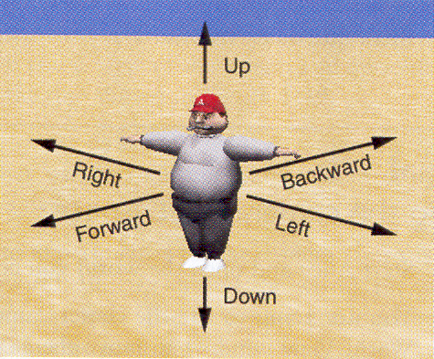
3D Movement
1.6
Motion is based on OBJECT’s perspective…our left is the Coach’s right
Forward is perceived as the object getting larger as it gets closer to us.
Backward is perceived as the object getting smaller as it gets farther away from us.

